Slide 1

Synaptix Digital Solution
Project Pioneer

Slide 2
Outline
1
2
3
4
5
Introduction
Business Summary
Visualization
Recommendation
Conclusion

Slide 3

Introduction
At Project Pioneer, we have been able to conduct index analysis for user engagement for Synaptix Digital solutions. By analyzing the company’s data and leveraging tools like SQL, PowerBI and Excel to help the organization make informed data driven decisions which will help the business grow organically. This analysis aims at helping the business experience an increase turn-over the next quarter.

Slide 4

Business Summary
Synaptix Digital Solution is a business that specializes in crafting innovative solutions that propel businesses into the digital frontier. The solutions they proffer ranges from streamlined automation to advanced analytics and are dedicated to empowering seamless journey through the digital landscape.

Slide 5


Slide 7
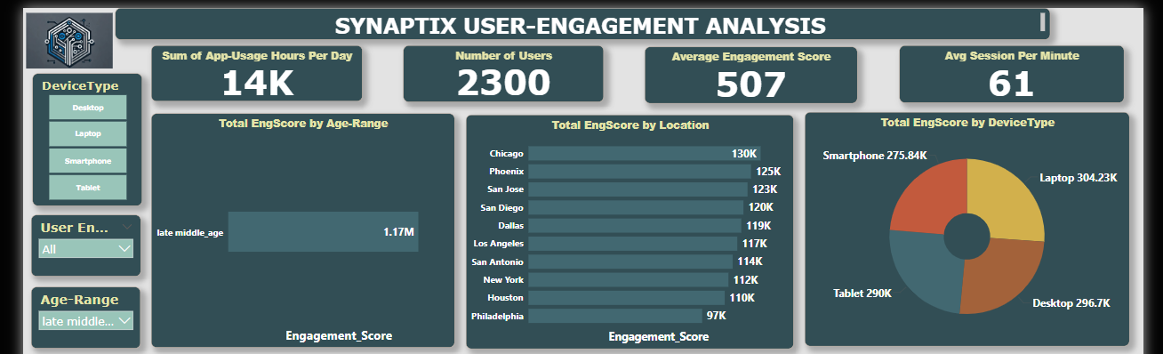
Engagement Score By User Segment
This board shows that the Users with highest engagement score are the Late Middle-Aged customers with a total engagement score of 1.17M. Using the Age-Range as a criteria, the similarities shows that these age range are also mostly located in Chicago and mostly use Laptops.

Slide 8
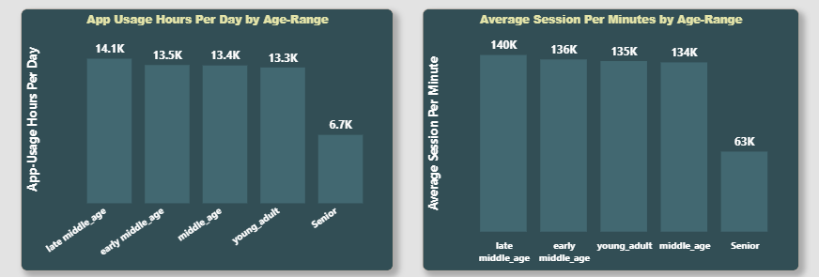
Users at Risk of Churning
Here, the users with the least engagement are the Seniors. This group of users in the chart have the lowest app usage hours as well as the lowest average session per minute with 6.7k and 63k respectively. This indicates that they are the most at risk of leaving.

Slide 9
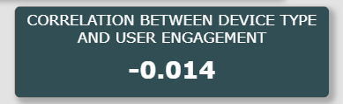
CORRELATION ANALYSIS
A correlation analysis was done to know if there exist a relationship between the device type used and the user engagement. A coefficient of -0.014 was found which suggests that there is a very weak negative relationship between the two variables.

Slide 10
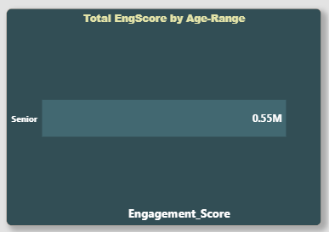
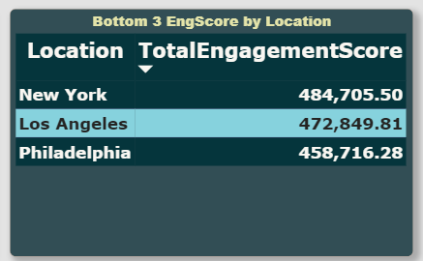
Least Performing Age-Range and Location
The figure above shows that the seniors are probably finding the app difficult to navigate. Hence, we’ll recommend that there should be a friendly user interface for these age-range as well as an audio feature that will help in navigating the app easily. In addition, Increasing the font size for easy reading and bright display colors. Research on Philadelphia being the least performing country suggests that there is need to create awareness around the cities such as indigenous advertisements.

Slide 11
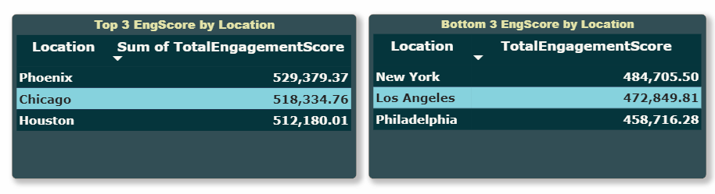
Location with Highest and Lowest Engagement
From the table, the locations with the highest engagements are Phoenix, Chicago and Houston with over 500,000 on average. While New York, Los Angeles and Philadelphia with over 400,000 on average. We can address this disparity by tailoring location specific advertisements and adopting the model that worked in the top locations to the bottom locations.

Slide 12
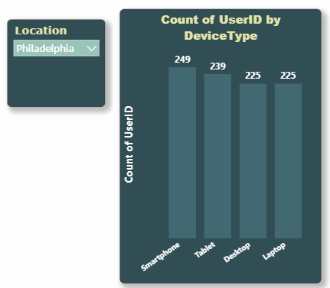
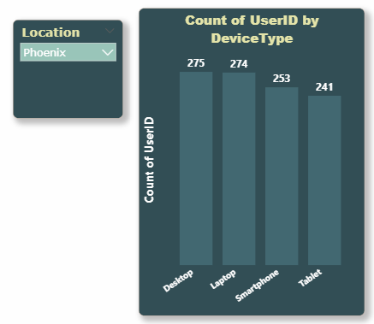
RECOMMENDATION
It is recommended that Synaptix should center their in app-features on the devices mostly used in Philadelphia. By creating features that are more appealing on Smartphones and Tablets this will increase user engagements and directly increase user retention.
Cultivate one-to-one customer service with robust ideas​ Maximize timely deliverables for real-time schemas

Slide 13
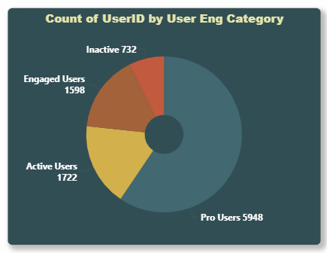
Recommendation
The Inactive and Engaged Users have Spent less than 3 hours per day on the app. A reward system can be put in place where it determines the longer the session, the increase in point which will increase user retention and app usage
The rewards can vary from points conversion to cash or free subscription to the business services. This will not only enhance the usage of the app but also incentivize the users to refer potential customers.

Slide 14
Recommendation
For the seniors who are the ones at more risk of churning. Synaptix Digital can develop retention tactics, like re-engagement emails or incentives to make them want to come to the app more.
For Philadelphia being the least performing location, the root cause of the issue in these location can be addressed such as cellular network providers. A partnership stakeholder meeting can be held for collaborative engagement of users.

Slide 15
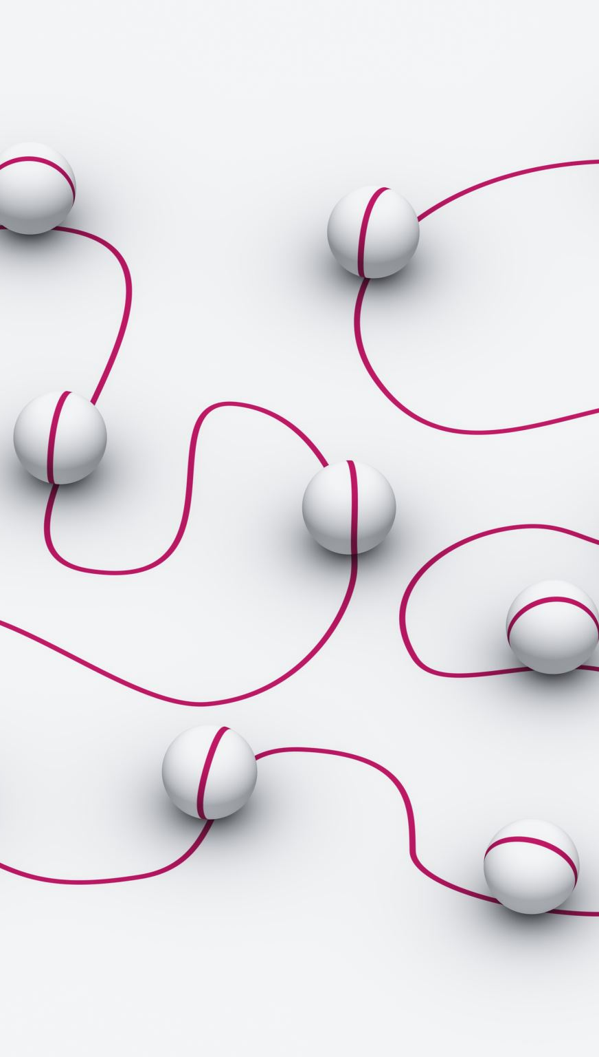
Conclusion
From our analysis, we have been able to identify valuable insights into the user engagement patterns within the app, offering a clear path to enhance retention and usage.
These finding shows that high-engagement users share specific traits, like device preference and consistent session durations, suggesting opportunities for personalized engagement strategies.

Slide 16
Thank you for you time.

